Slide 1
Text Mining, Information and Fact Extraction
Part 4: Applications
Marie-Francine Moens
Department of Computer Science
Katholieke Universiteit Leuven, Belgium sien.moens@cs.kuleuven.be

Slide 2
General setting
Information extraction: has received during decades a large interest because of its applicability to many types of information
In IR context: interest in IE from text is boosted by growing interest in IE in other media (e.g., images, audio)
Note: performance statistics given in this chapter are only indicative and refer to a particular setting (corpus, features used,classification algorithm, ...)

Slide 3
Overview
Generic versus domain-specific character of IE tasks
Possible applications:
  Processing of news texts
  Processing of biomedical texts
  Intelligence gathering
  Processing of business texts
  Processing of law texts
  Processing of informal texts

Slide 4
Overview
Specific case studies:
  Recognizing emotions expressed towards product or person (joint work with Erik Boiy)
  Recognizing actions and emotions performed or expressed by persons (joint work with Koen Deschacht)

Slide 5
Generic versus domain specific character
Generic information extraction and text mining: use of generic ontology or classification scheme
  Named entity recognition (person, location names, ...)
  Noun phrase coreference resolution
  Semantic frames and roles, ...
Domain-specific information extraction and text mining: use of ontology of domain-specific semantic labels
Techniques and algorithms are fairly generic

Slide 6
Processing news texts
Very traditional IE boosted by Message Understanding Conferences (MUC) in late 1980s and 1990s (DARPA), followed by Automatic Content Extraction (ACE) initiative and Text Analysis Competition (TAC) (NIST)
Tasks:
  Named entity recognition
  Noun phrase coference resolution
  Entity relation recognition
  Event recognition (who, what, where, when)

Slide 7
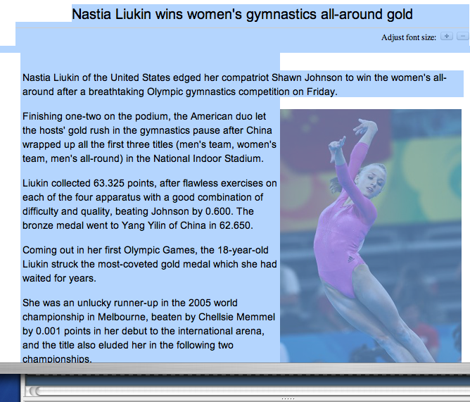
WHO?
WHEN?
WHAT?
WHERE?
www.china.org.cn

Slide 8
Processing news texts
Named entity recognition:
  Person, location, organization names
  Mostly supervised: Maxent, HMM, CRF
  Approaches human performance: in literature sometimes above 95% F₁ measure
[Bikel et al. ML1999] [Finkel et al. 2006]
Noun phrase coreference resolution:
  Although unsupervised (clustering), and semi-supervised (co-training), best results with supervised learning: F₁ measures of 70% and more are difficult to reach; also kernel methods
[Ng & Cardie ACL 2002] [Ng & Cardie HLT 2003] [Versley et al. COLING 2008]

Slide 9
Processing news texts
Entity relation recognition:
  use of supervised methods: e.g., kernel methods: F₁ measures fluctuate dependent on number of training examples and difficulty of the relational class (ambiguity of the features)
[Culotta & Sorensen ACL 2004] [Girju et al. CSL 2005]
Event recognition:
  in addition: recognition and resolution of:
    temporal expressions: TimeML
    spatial expressions: FrameNet and Propbank
[Pustejovsky et al. IWCS-5 2003] [Baker et al. COLING-ACL 1998] [Morarescu IJCAI 2007] [Palmer et al. CL 2005]

Slide 10
Processing news texts
Challenges:
  Cross-document, cross-language and cross-media (video !):
    named entity recognition and resolution
    event recognition:
      including cross document temporal and spatial resolution

Slide 11
Processing biomedical texts
Many ontologies or classification schemes and annotated databases are available:
    E.g., Kyoto Encyclopedia of Genes and Genomes, Gene Ontology, GENIA dataset
Tasks:
  Named entity recognition
  Relation recognition
  Location detection and resolution

Slide 12
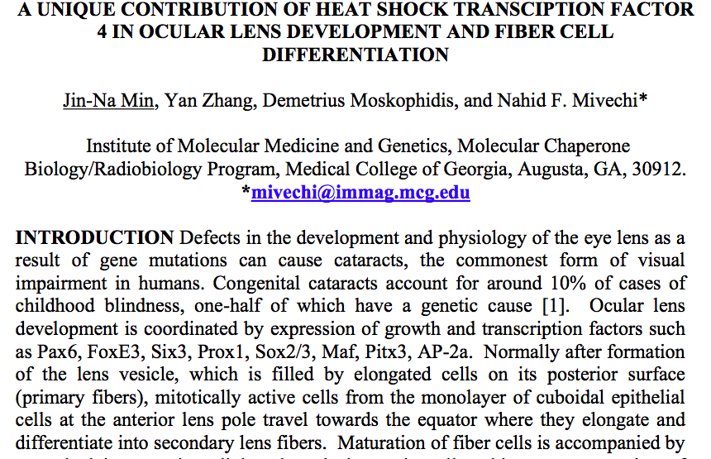

Slide 13
Processing biomedical texts
Named entity recognition: difficult:
    boundary detection:
      capitalization patterns: often misleading
      many premodifiers or postmodifiers that are part or not of the entity (91 kDA protein, activated B cell lines)
    polysemous acronyms and terms: e.g., PA can stand for pseudomonas aeruginosa, pathology and pulmonary artery
    synonymous acronyms and terms
  Supervised context dependent classification: HMM, CRF: often F₁ measure between 65-85%
  [Zhang et al. BI 2004]

Slide 14
Processing biomedical texts
Entity relation recognition:
  Protein relation extraction
  Literature based gene expression analysis
  Determination of protein subcellular locations
  Pathway prediction (cf. event detection)
    methods relying on symbolic handcrafted rules, supervised (e.g., CRF) and unsupervised learning
  [Stapley et al. PSBC 2002] [Glenisson et al. SIGKDD explorations 2003] [Friedman et al. BI 2001] [Huang et al. BI 2004] [Gaizauskas et al. ICNLP workshop 2000]

Slide 15
Intelligence gathering
Evidence extraction and link discovery by police and intelligence forces from narrative reports, e-mails and other e-messages, Web pages, ...
Tasks:
  Named entity recognition, but also brands of cars, weapons
  Noun phrase coreference resolution, including strange aliases
  Entity attribute recognition
  Entity relation recognition
  Event recognition (recognition and resolution of temporal and spatial information; frequency information !)

Slide 16

www.kansascitypi.com

Slide 17
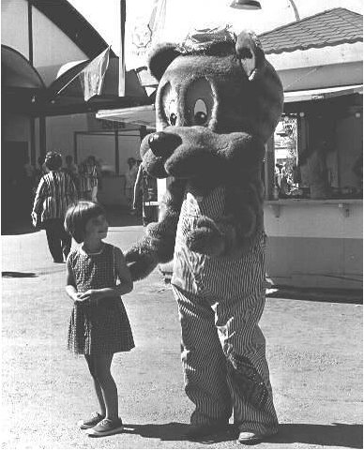

Intelligence gathering
See above news processing
Entity attribute recognition: often visual attributes, very little research;
  recognition of visual attributes in text based on association techniques (e.g., chi square) of word and textual description of image
African violets (Saintpaulia ionantha) are small,
flowering houseplants or greenhouse plants belonging
to the Gesneriaceae family. They are perhaps the most
popular and most widely grown houseplant.
Their thick, fuzzy leaves and abundant blooms in
soft tones of violet, purple, pink, and white make
them very attractive...
A small girl looks up at a person dressed in the costume of an anima
which could be "Woody Woodchuck" at the State Fair in Salem, Oregon.
[Boiy et al.TIR 2008]

Slide 18
Intelligence gathering
Challenges:
  Texts are not always well-formed (spelling and grammatical errors): drop in F₁ measures compared to standard language
  Often important to detect the single instance
  Combination with mining of other media (e.g., images, video)
  Recognition of temporal and spatial relationships, recognition of other rhetorical relationships (e.g., causal) [Hovy AI 1993] [Mann & Thompson TR 1997] [Mani 2000]
  Extracted information is often used to build social networks, which can be mined for interesting patterns

Slide 19
Processing business texts
Wealth of information can be found in technical documentation, product descriptions, contracts, patents, Web pages, financial and economical news, blogs and consumer discussions
Business intelligence (including competitive intelligence): mining of the above texts

Slide 20
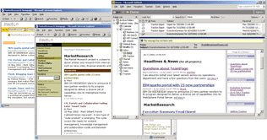

traction.tractionsoftware.com
www.robmillard.com

Slide 21
Processing business texts
Tasks:
  Named entity recognition: including product brands
  Entity attributes: e.g., prices, properties
  Sentiment analysis and opinion mining

Slide 22
Processing law texts
Processing legislation, court decisions and legal doctrine
Tasks:
  Named entity recognition
  Noun phrase coreferent resolution
  Recognition of factors and issues
  Recognition of arguments
  Link mining
For a long time: low interest, but since 2007: TREC legal track (NIST)

Slide 23



Slide 24
Processing law texts
Recognition of factors and issues in cases:
  factor = a certain constellation of facts
  issue = a certain constellation of factors
Limited attempts to learn factor patterns from annotated examples based on a naive Bayes and decision tree learners
Difficulties:
  ordinary language combined with a typical legal vocabulary, syntax and semantics: making disambiguation, part-of-speech tagging and parsing less accurate
[Brüninghaus & Ashley 2001]

Slide 25
Processing law texts
Recognition of argumentation and its composing arguments in cases:
  an argument is composed of zero or more premises and a conclusion
  discourse structure analysis
Difficulties:
  see recognition of factors and issues
  discourse markers are ambiguous or absent
  argument are nested (conclusion of one argument is premise of another argument)
  difficult style: humans have difficulty to understand the content [Mochales Palau & Moens 2008]

Slide 26
Processing informal texts
Many texts diverge from standard language when created or when processed:
  Spam mail
  Blog texts
  Instant messages
  Transcribed speech
  ...

Slide 27
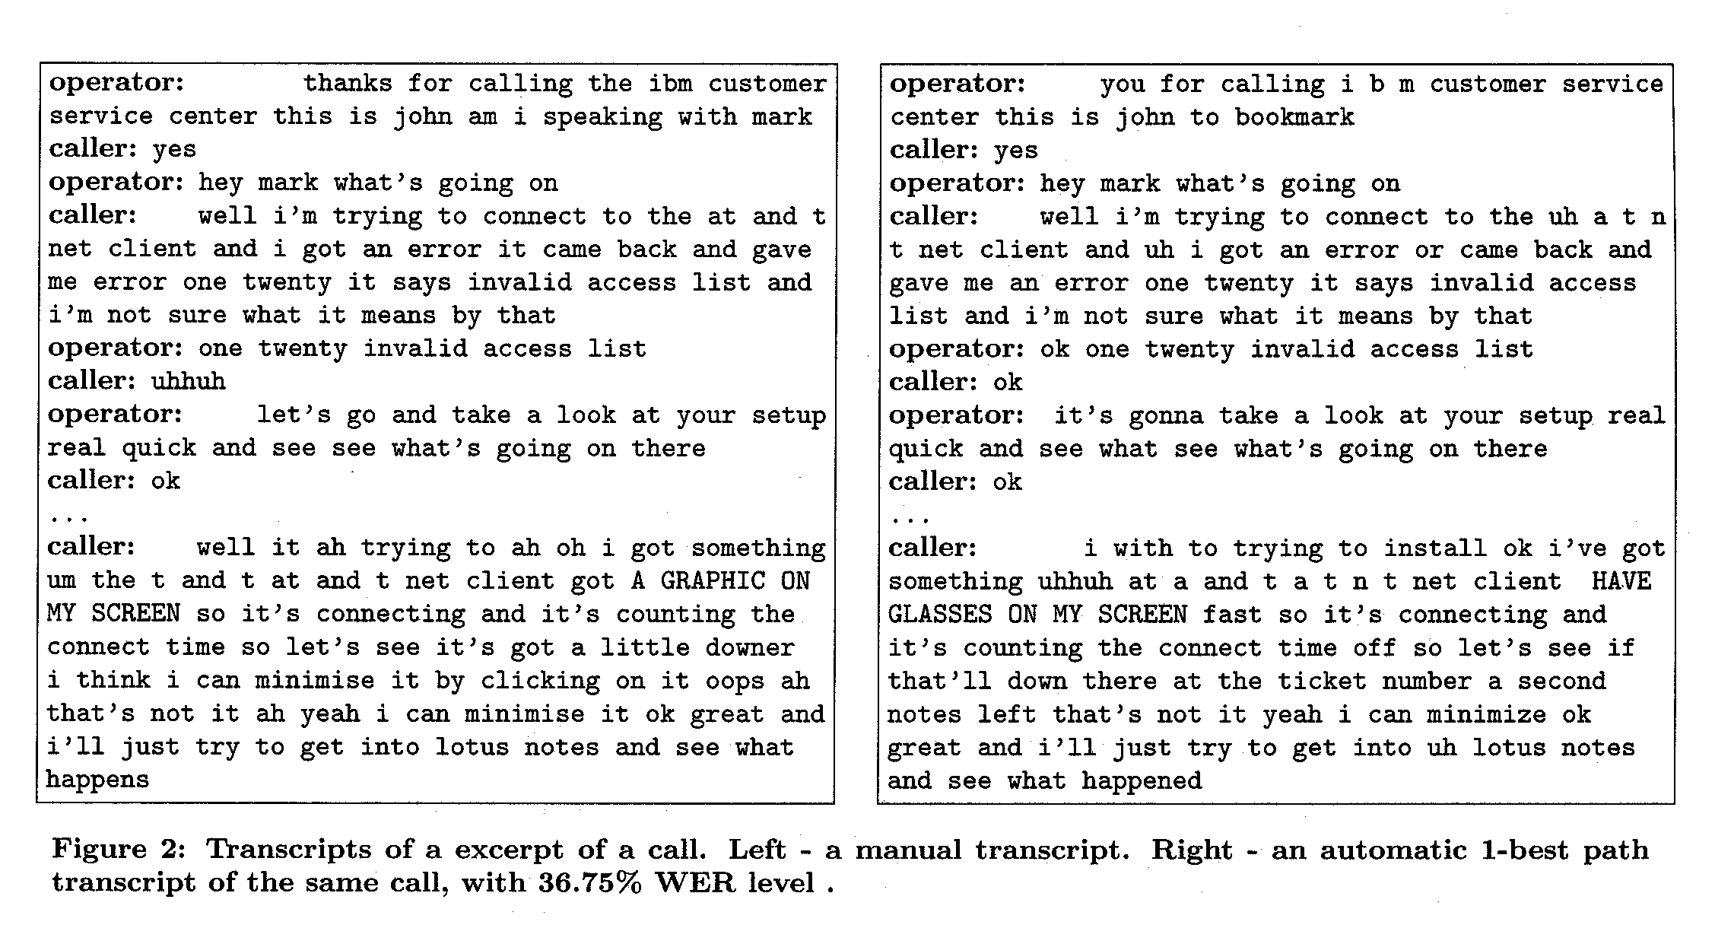
[Mamou et al. SIGIR 2006]
Source: Mamou et al. 2006

Slide 28
Processing informal texts
Accuracy of the extraction usually drops proportional with the amount of noise
Solutions:
  Preprocessing: e.g., most likely normalization based on string edit distances, language models
  Incorporating different hypotheses into the extraction process

Slide 29
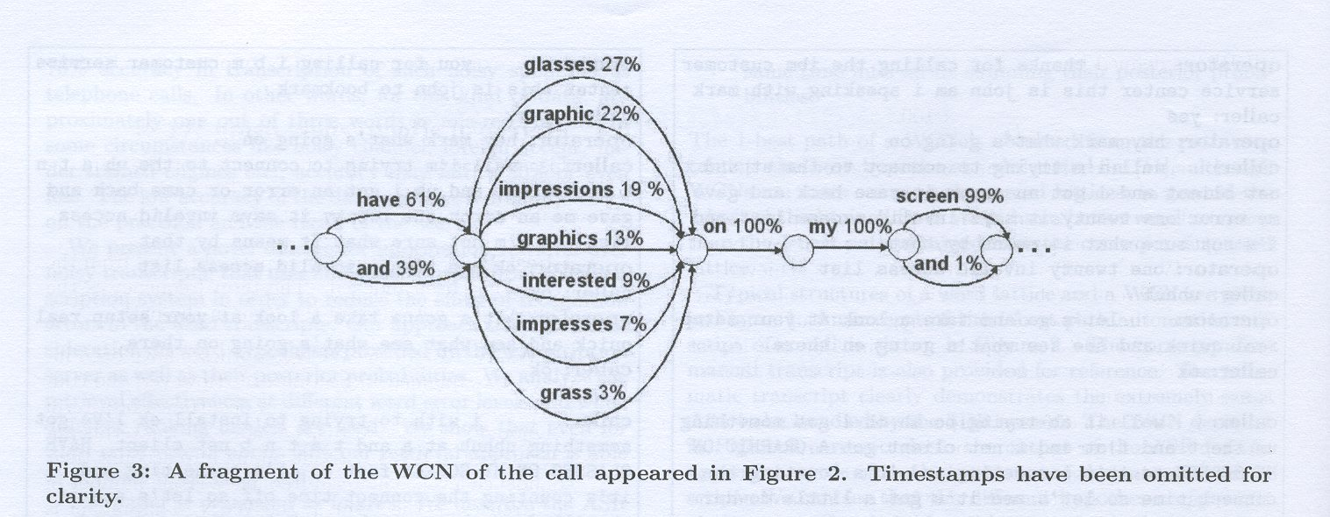
Processing informal texts
[Mamou et al. SIGIR 2006]

Slide 30
Case studies

Slide 31
Case 1: Emotion expressed towards person or product
Learning emotion patterns in blog, review and news fora texts:
  Positive, negative and neutral feeling
Problems:
  Large variety of expressions (noisy texts !!!) and relatively few annotated examples
  Emotion is attributed to an entity
  Language/domain portability (English, Dutch and French blogs)
  How to reduce the annotation of training examples?

Slide 32
The movie really seems to be spilling the beans on a lot of stuff we didnt think we hand if this is their warm up, what is going to get us frothing in December
de grote merken mogen er dan patserig uitzien en massa's pk hebben maar als de bomen wat dicht bij elkaar staan en de paadjes steil en bochtig,dan verkies ik mijn Jimny.
L’é tro bel cet voitur Voici tt ce ki me pasione ds ma petite vi!!!é tt mé pote é pl1 dotre truk!!!Avou de Dcouvrir
-
-+
+

Slide 33
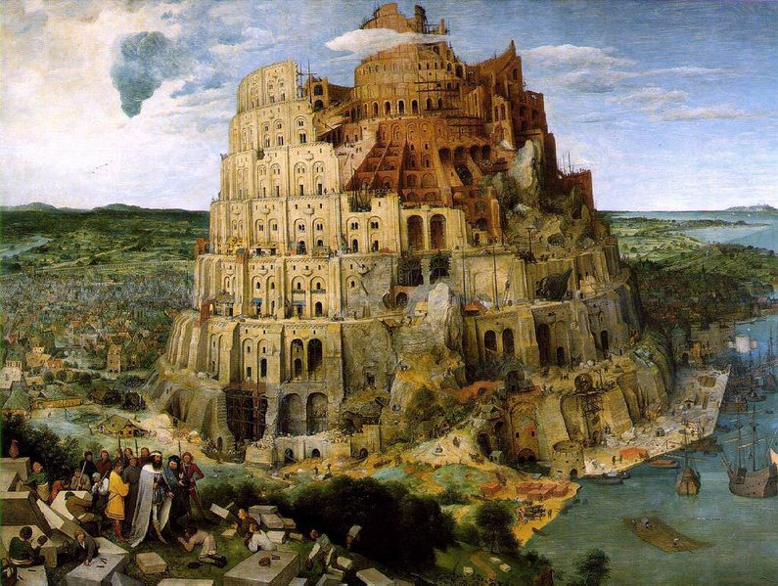

Slide 34
Case 1: Emotion is expressed towards person or object
Solutions tested:
  Feature extraction
  Single classifier versus a cascaded classifier versus bagged classifiers
  Active learning
[Boiy & Moens IR 2008]

Slide 35
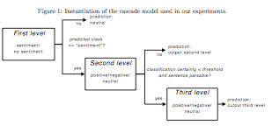
[Boiy & Moens IR 2008]

Slide 36
Case 1: Emotion is expressed towards person or object
Corpus:
  blogs: e.g., skyrock.com, lifejournal.com, xanga.cpm, blogspot.com; review sites: e.g., amazon.fr, ciao.fr, kieskeurig.nl; news fora: e.g., fok.nl, forums.automotive.com
  750 positive, 750 negative and 2500 neutral sentences for each language
  interannotator agreement: κ = 82%
Codes in the table below:
  SC uni: unigram features
  SC uni-lang: + language (negation, discourse) features
  SC uni-lan-dist: + distance in number of words with entity feature

Slide 37
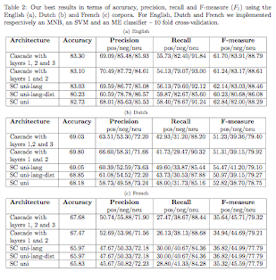
[Boiy & Moens IR 2008]

Slide 38
Inter-annotator agreement
Kappa statistic: agreement rate when creating ‘gold standard’ or ‘ground truth’ corrected for the rate of chance agreement
where
  P(A)= proportion of the annotations on which the annotators agree
  P(E) = proportion of the annotations on which annotations would agree by chance
κ > 0.8: good agreement
0.67 <= κ <=0.8: fair agreement
More than 2 judges: compute average pairwise κ

Slide 39
Active learning
Active learning = all examples to train from are labeled by a human, but the set of examples is carefully selected by the machine
(Starts with labeled set on which the classifier is trained)
Repeat
  1 or a bucket of examples are selected to label:
    which are classified by the current classifier as most uncertain (informative examples)
    that are representative or diverse (e.g., found by clustering)
Until the trained classifier reaches a certain level of accuracy on a test set

Slide 41
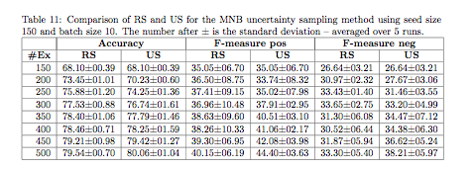
Case 1: Emotion is expressed towards person or object
Active learning techniques tested on English corpus:
  Uncertainty sampling (US): to find informative examples
  Relevance sampling (RS): to find more negative examples
  Combination of US and RS yielded best results:

Slide 42
Case 2: Person performs action or expresses emotion
Semantic role labeling:
Recognizing the basic event structure of a sentence (“who” “does what” “to whom/what” “when” “where” ...): semantic roles that form a semantic frame
  Maria Sharapova walks towards the field.
  x₁ x₂ x₃ x₄
  y₁ y₂ y₃ y₄
  actor movementAction toLocation toLocation

Slide 43
CLASS (EU: 2006-2008)
Source: Buffy
Text of script: 51: Shot of Buffy opening the refrigerator and taking out a carton of milk.

Slide 44

Willow hugs Buffy.
Semantic role and frame detection:
  Supervised learning (state of the art)
  [Gildea & Jarowsky CompLing 2002][CompLing 2008]
  Our task:
    weakly supervised learning
    combine with evidence from the images (e.g., movement)

Slide 45
Case 2: Person performs action or expresses emotion
Classification of semantic frames in text: validation of 353 sentences (1 episode) from transcripts of fans of “Buffy the Vampire Slayer” (trained on 7 episodes)
Evaluation of several classification models:
  Supervised learning:
    HMM
    CRF
  Semi-supervised: learning from unlabeled examples: learning of multiple mixture models, inference based on expectation maximization, approximate inference (Markov chain Monte Carlo sampling methods)
[Deschacht & Moens Technical Report 2008]

Slide 46
Case 2: Person performs action or expresses emotion
Problem:
  large number of patterns that signal a semantic frame/role
  relies on sentence parse features which might be erroneous
Results might be improved by sentence simplification techniques:
  application of a series of hand-written rules for syntactic transformation of the sentence, where the weights of the rules and the SRL model is learned
  [Vickrey & Koller ACL 2008]

Slide 47
Conclusions
Use of current information extraction technologies yield valuable input for:
  Automatic search and linking of information
  Automatic mining of extracted information
But also can offer a competitive advantage for businesses:
  Knowledge on competitors’ products, prices, contacts, ...
  Knowledge of consumers’ attitudes about products, ...
  ...
But not always transparent what kind of information can be found, linked, inferred, ...
So, be careful what you write ...

Slide 48


TIME (IWOIB: 2006-2007)‏
  Advanced Time-Based Text Analytics
  Partner: Attentio, Belgium
CLASS (EU FP6: 2006-2008)‏
  Cognitive Level Annotation Using Latent Statistical Structure
  Partners: K.U.Leuven, INRIA, Grenoble, France, University of Oxford, UK, University of Helsinki, Finland, Max-Planck Institute for Biological Cybernetics, Germany
...

Slide 49
References
Baker, C.F., Fillmore, C.J. & Lowe, J.B. (1998). The Berkeley FrameNet project. In Proceedings of the COLING-ACL, Montreal, Canada.
Bikel, D. M., Schwartz R. & Weischedel, R.M. (1999). An algorithm that learns what’s in a name. Machine Learning, 34, 211-231.
Brüninghaus, S. & Ashley, K.D. (2001). Improving the representation of legal case texts with information extraction methods. In Proceedings of the 8th International Conference on Artificial Intelligence and Law (pp. 42-51). New York: ACM.
Boiy, E. & Moens M. -F. (2008) A machine learning approach to sentiment analysis in multilingual Web texts. Information Retrieval (accepted for publication), 30 p.
Boiy, E., Deschacht, K. & Moens M.-F. (2008) Learning visual entities and their visual attributes from text corpora In Proceedings of the 5thInternational Workshop on Text-based Information Retrieval . IEEE Computer Society Press.
Cullota, A. & Sorensen, J. (2004). Dependency tree kernels for relation extraction. In Proceedings of the 42nd Annual Meeting of the Association for Computational Linguistics (pp. 424-430). East Stroudsburg, PA: ACL.
Friedman, C., Kra, P., Yu, H., Krauthammer, M. & Rzetsky, A. (2001). GENIES: A natural language processing system for the extraction of molecular pathways from journal articles. ISMB (Supplement of Bioinformatics), 74-82.
Finkel, J. et al. (2005). Reporting the boundaries: Gene and protein identification in biomedical text. BMC Bioinformatics 2005, 6 (Suppl I): S5.

Slide 50
References
Gaizauskas, R. J., Demetriou, G. & Humphreys, K. (2000). Term recognition and classification in biological science journal articles. In Proceedings of the Computational Terminology for Medical and Biological Applications Workshop of the 2nd International Conference on NLP (pp. 37-44).
Glenisson, P., Mathijs, J., Moreau, Y. & De Moor, B. (2003). Meta-clustering of gene expression data and literature-extracted information. SIGKDD Explorations, Special Issue on Microarray Data Mining, 5 (2), 101-112.
Gildea, D. & Jurafsky, D. (2002). Automatic labeling of semantic roles. Computational Linguistics, 28 (3), 245-288
Girju, R., Moldovan, D.I., Tatu, M. & Antohe, D. (2005). On the semantics of noun compounds. Computer Speech and Language, 19 (4), 479-496.
Hovy, E. (1993). Automatic discourse generation using discourse structure relations. Artificial Intelligence, 63 (1-2), 341-385.
Huang, M. et al. (2004). Discovering patterns to extract protein-protein interactions from full text. Bioinformatics, 20 (18), 3604-3612.
Mamou, J. Carmel, D. & Hoory R. (2006). Spoken document retrieval from call-center conversations. In Proceedings of Twenty-Ninth Annual International ACM SIGIR Conference on Research and Development of Information Retrieval (pp. 51-58). New York: ACM.
Mann, William C. and Sandra A. Thompson (1987). Rhetorical Structure Theory: A Theory of Text Classification. ISI Report ISI/RS-87-190. Marina del Rey, CA: Information Sciences Institute.
Marcu, D. (2000). The Theory and Practice of Discourse Parsing and Summarization. Cambridge, MA: The MIT Press.
Morarescu P. (2007). A Lexicalized Ontology for Spatial Semantics. In Proceedings of the IJCAI-2007 Workshop on Modeling and Representation in Computational Semantics.

Slide 51
References
Ng, V & Cardie, C. (2002). Improving machine learning approaches to coreference resolution. In Proceedings of the 40th Annual Meeting of the Association for Computational Linguistics (pp. 104-111). San Francisco, CA: Morgan Kaufmann.
Ng, V. & Cardie, C. (2003). Weakly supervised natural language learning without redundant views. In Proceedings of the Human Language Technology Conference (pp. 183-180). East Stroudsburgh, PA: ACL.
Palmer M., Gildea D., Kingsbury P. (2005). The Proposition Bank: A corpus annotated with semantic roles. Computational Linguistics Journal, 31 (1), 2005.
Pustejovsky J., Castaño J., Ingria R., Saurí R., Gaizauskas R., Setzer A. & Katz G. (2003). TimeML: Robust specification of event and temporal expressions in text. In IWCS-5 Fifth International Workshop on Computational Semantics, 2003.
Stapley, BJ, Kelley LA and Sternberg MJ (2002). Predicting the sub-cellular location of proteins from using support vector machines. Pacific Symposium Biocomputing, 374-385.
Versley, Y., Moschitti, A., Poesio M. & Yang,, X. (2008). Coreference systems based on kernel methods. In Proceedings COLING 2008.
Vickrey, D. & Koller, D. (2008). Sentence simplification for semantic role labeling. In Proceedings of the 46th Meeting of the Association for Computational Linguistics.
Zhang, Jie, Dan Shen, Guodong Zu, Su Jian and Chew-Lim Tan (2004). Enhancing HMM-based biomedical named entity recognition by studying special phenomena. Journal of Biomedical Informatics, 37, 411-422.

